Slide 1
Team Sarvatra

Slide 2
Problem Statement
Primary: Searching Queried Image in the pre-existing database.
Front End based Application to search a Queried Image from/for the following:
Live Video Stream (CCTV Footage)
Given Video File (speeds up Investigation)
Web Sites (Web Image Scraping)
Synthetic Image Generation (Various Age and Styles)
Anthropometric Profiling (Gender, Age)

Slide 3
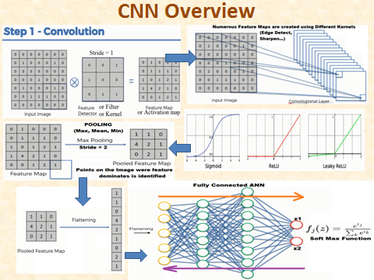
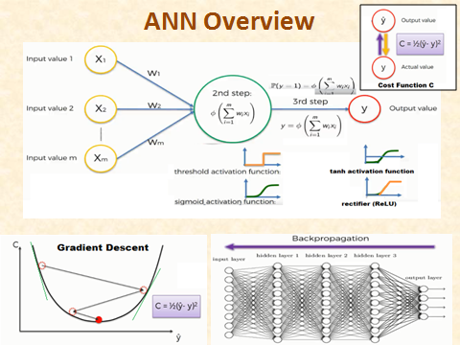
Technology Used
GAN
CNN
Siamese Network (for Image Comparison)
Transfer Learning

Slide 4

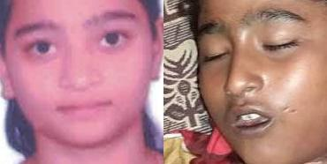


Image Matches Found (Unsupervised Learning for Search Space Minimization )
Disfigured Images
Various Age groups
Other Similar Images

Slide 5

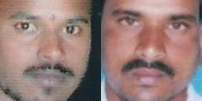

Image Matches contd…

Slide 6
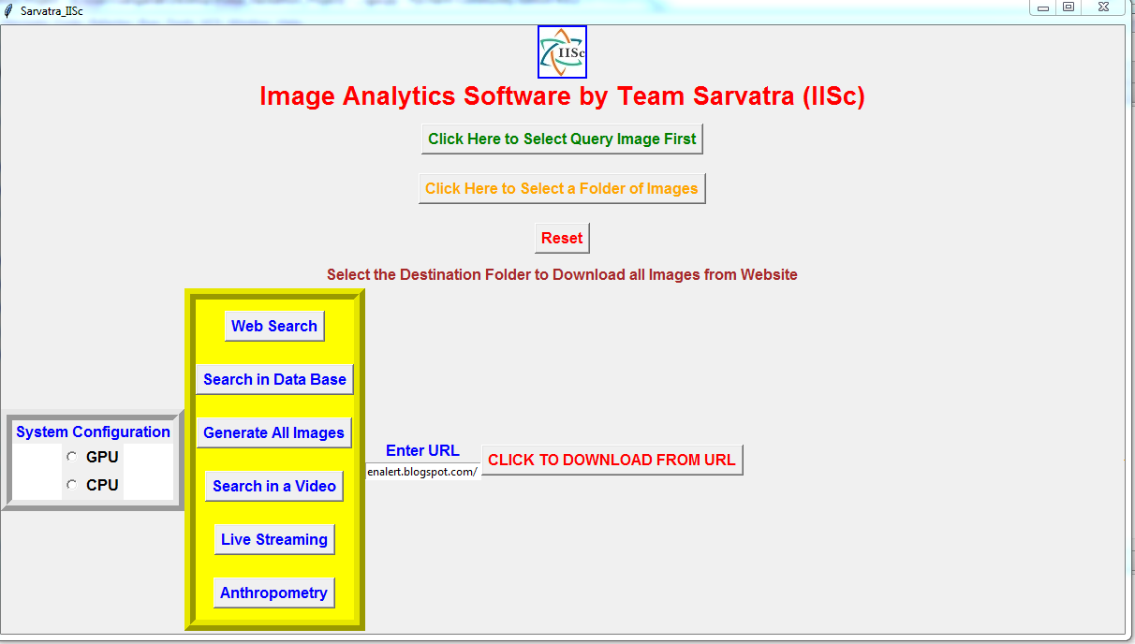
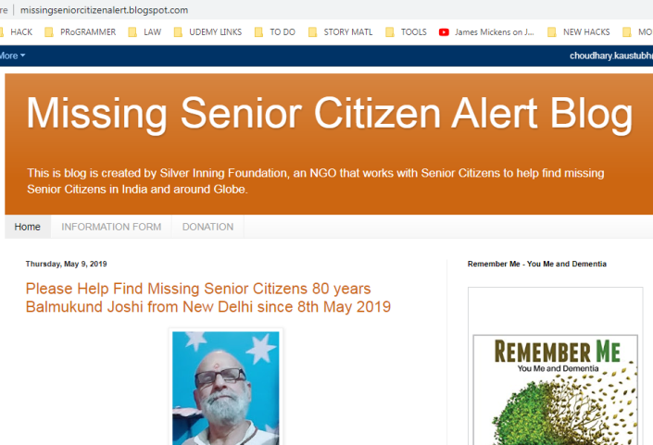
Application Front End

Slide 7
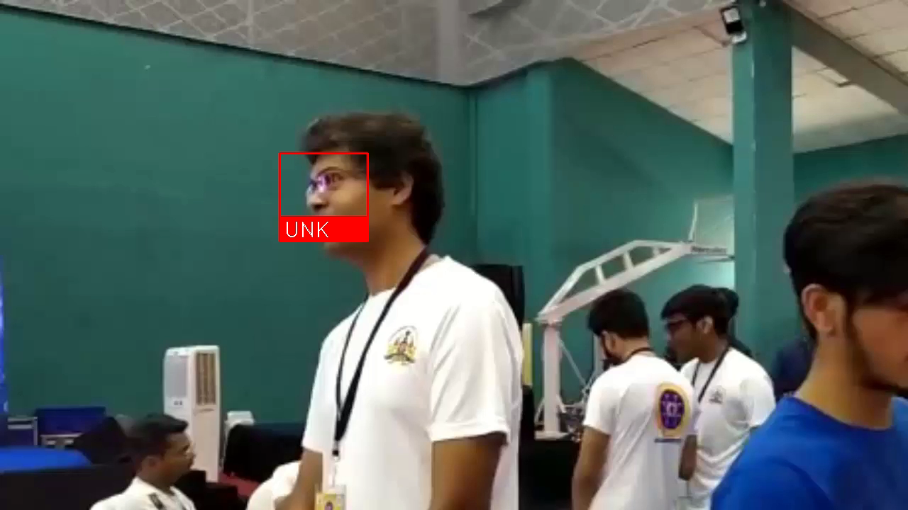
Image Detection in Video

Slide 8
Strengths of the Solution
Robust: Able to detect :
face of same person across various age groups.
Detects a face in a database of Disfigured faces
Basic OSINT Capabilities (Web Image Scraping and Live Video Streaming)
Front End: Interactive and User friendly (GUI).
Synthetic Enhancement of Image Quality
Portable (.exe files generated)

Slide 9
Challenges Met and Solutions
Isolating face from the given image (solved by face detection algorithms)
Changes in Facial Features with age (GAN)
WebInt/Scrapping led to Large Image Data Generation (segregation tree)
Blurred / Disfigured Images (SR-GAN)

Slide 10
Demo (Interesting Results)

